Slide 1
PX4 Autopilot
Firmware Guide (Spring-22)
Please keep editing if you find mistakes

Slide 2
Multicopter Control Architecture

Slide 3
Multicopter Control Architecture
http://docs.px4.io/master/en/concept/architecture.html
http://docs.px4.io/master/en/concept/px4_systems_architecture.html
https://www.youtube.com/watch?v=nEo4WGl4Lgc&t=118s

Slide 4
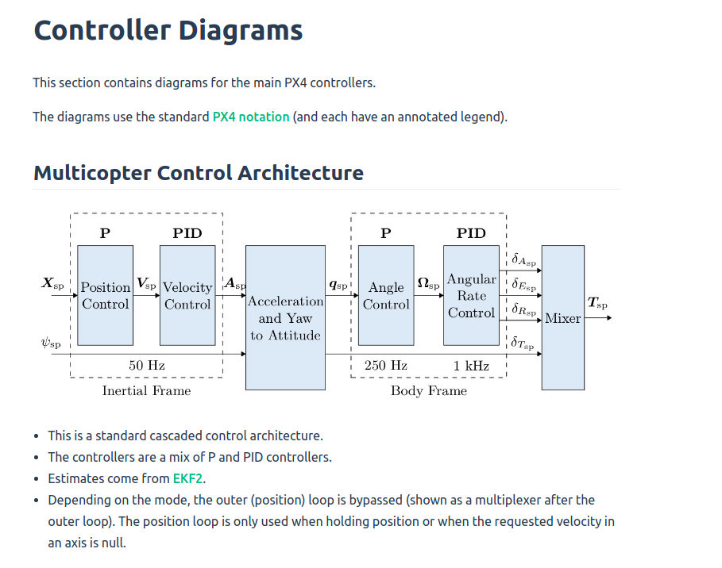
Multicopter Control Architecture
http://docs.px4.io/master/en/flight_stack/controller_diagrams.html

Slide 5
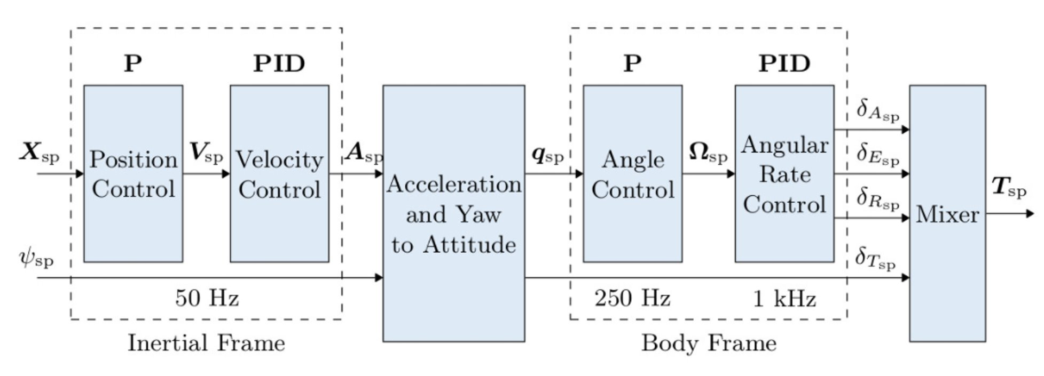
Github Repo
https://github.com/PX4/PX4-Autopilot/blob/master/src/modules
mc_pos_control
PositionControl
PositionControl.cpp
PositionControl.hpp
MulticopterPositionControl.cpp
MulticopterPositionControl.hpp
mc_att_control
AttitudeControl
AttitudeControl.cpp
AttitudeControl.hpp
mc_att_control.cpp
mc_att_control.hpp

Slide 6
Position & Velocity Control

Slide 7
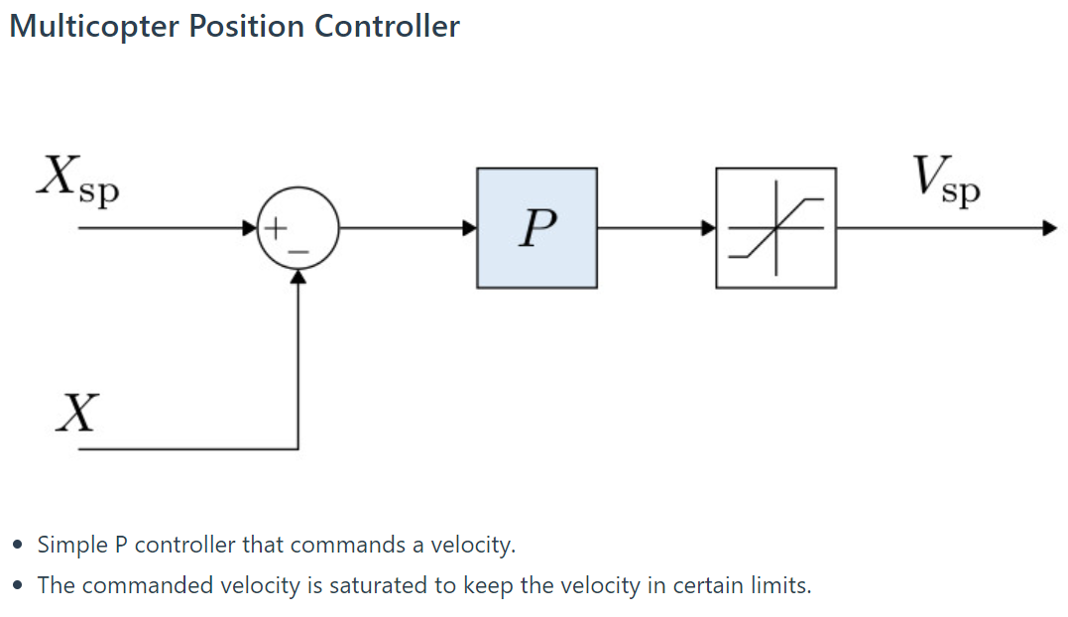
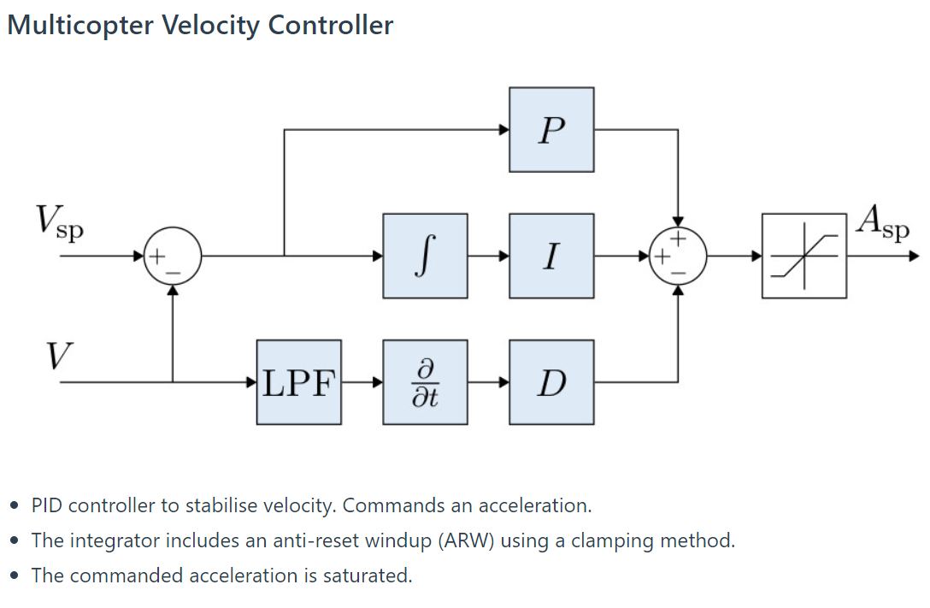
Position & Velocity Control
http://docs.px4.io/master/en/flight_stack/controller_diagrams.html

Slide 8
Codeflow
mc_pos_control:
mc_pos_control
MulticopterPositionControl.cpp
MulticopterPositionControl.hpp
mc_pos_control/PositionControl
PositionControl.hpp
PositionControl.cpp
Change here for custom control parameters or for adding extra functions

Slide 9
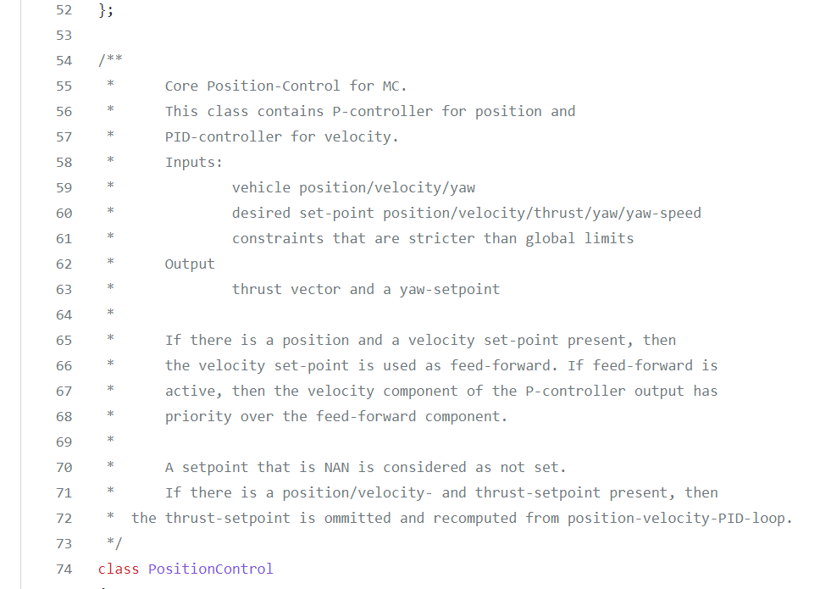
Setpoint Hierarchy
If position-setpoint && velocity-setpoint true:
(Velocity component of P-Controller) >>> (feed-forward component from velocity-setpoint)
If position/velocity-setpoint && thrust-setpoint true:
thrust-setpoint omitted and recomputed from next cascade/step in the architecture (i.e. Velocity PID controller)
mc_pos_control/PositionControl/PositionControl.hpp

Slide 10
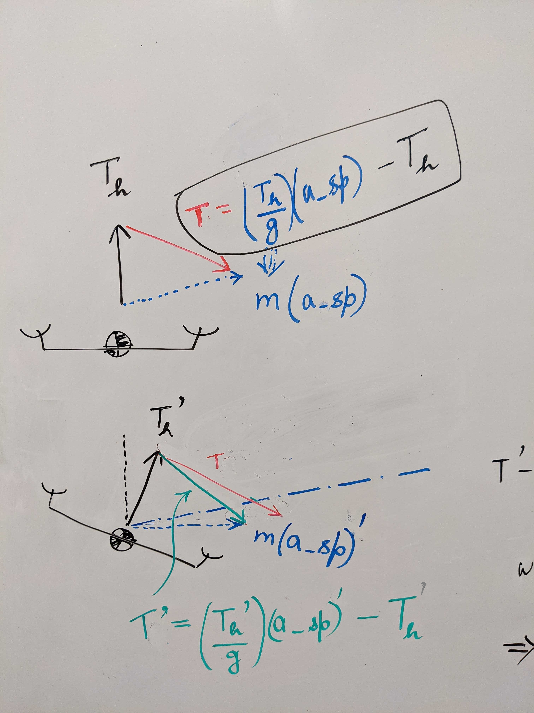
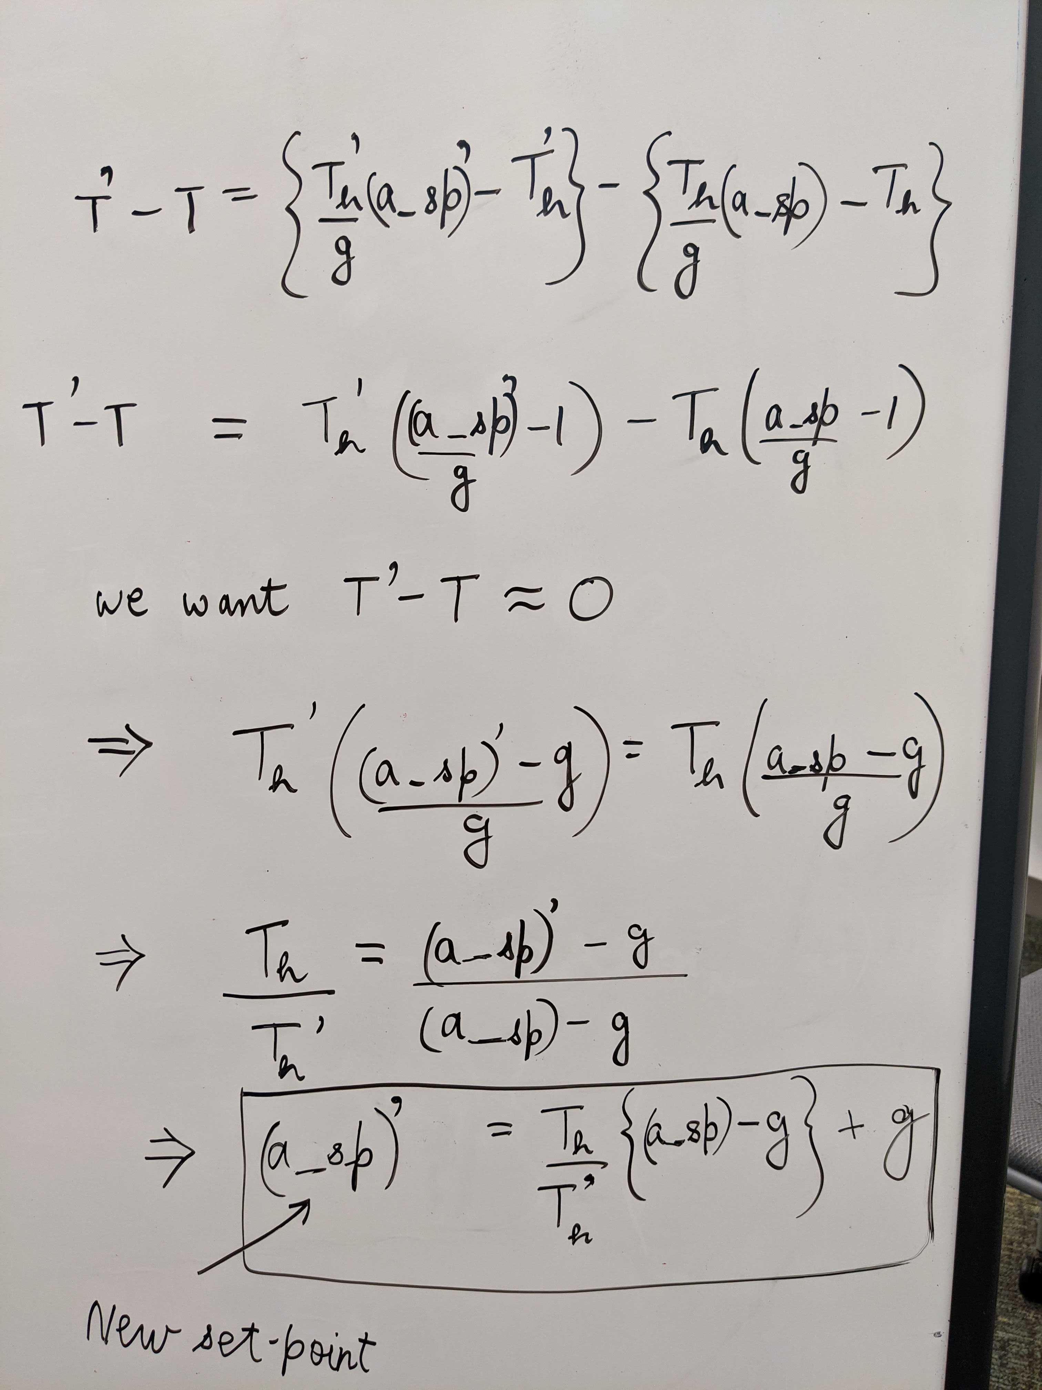
Hover Thrust Update
void PositionControl::updateHoverThrust(const float hover_thrust_new)
Line 73-85
mc_pos_control/PositionControl/PositionControl.cpp

Slide 11
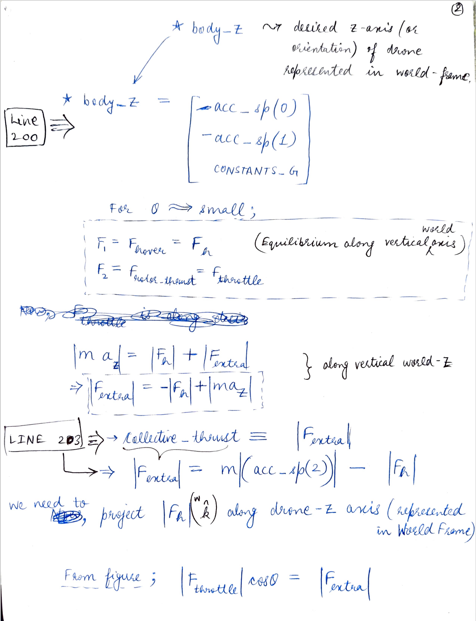
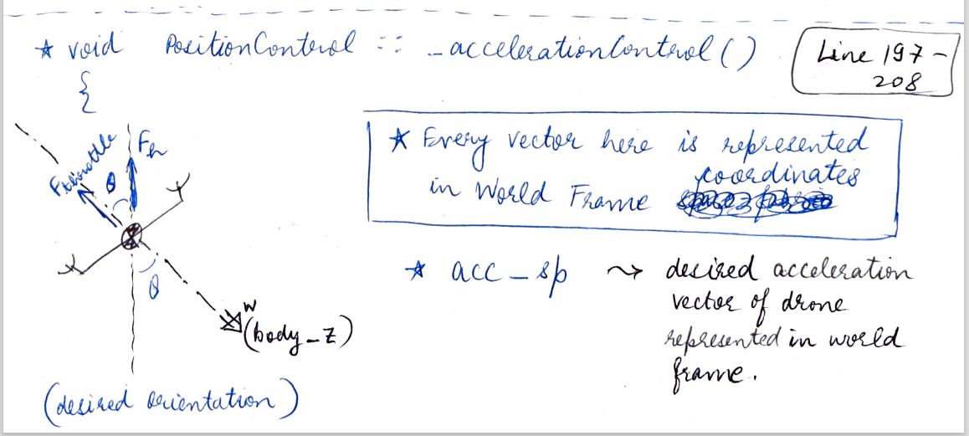
Thrust Setpoint and Acceleration Setpoint (1)
Output of Velocity-PID block
void PositionControl::_accelerationControl
Line 197-208
This is called earlier in void PositionControl::_velocityControl()
mc_pos_control/PositionControl/PositionControl.cpp

Slide 12
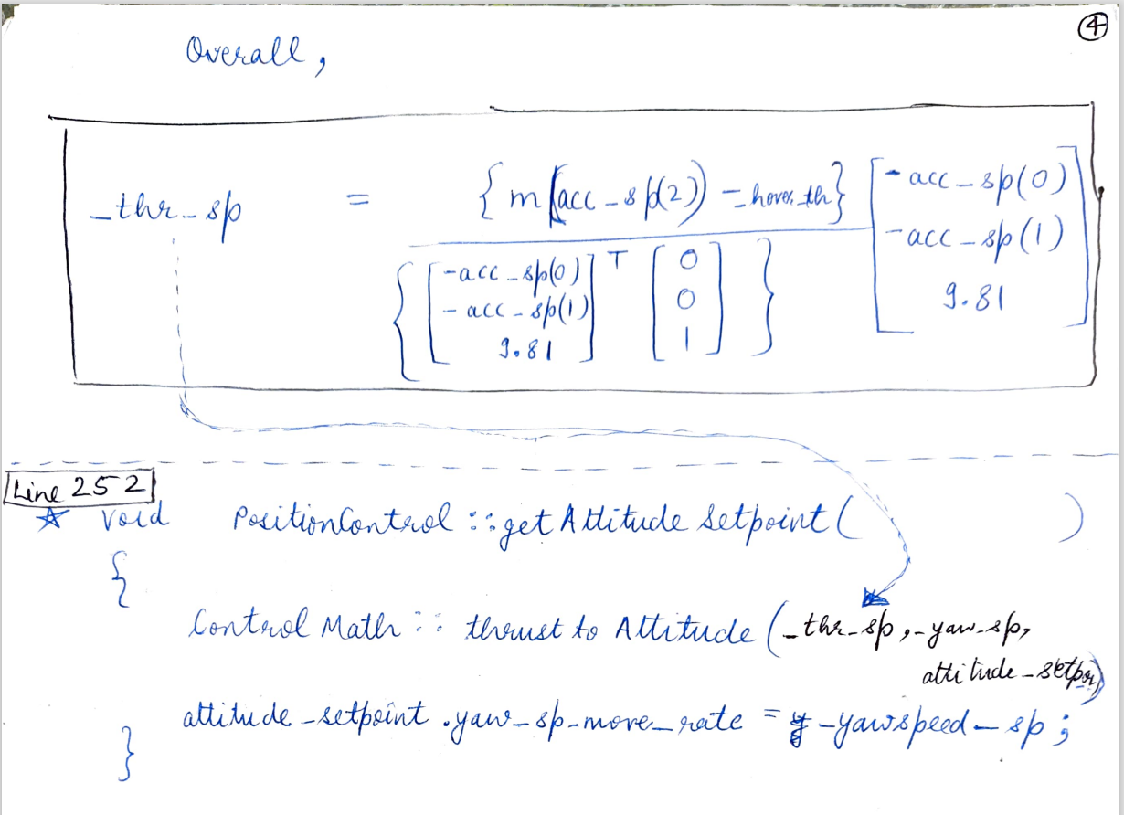
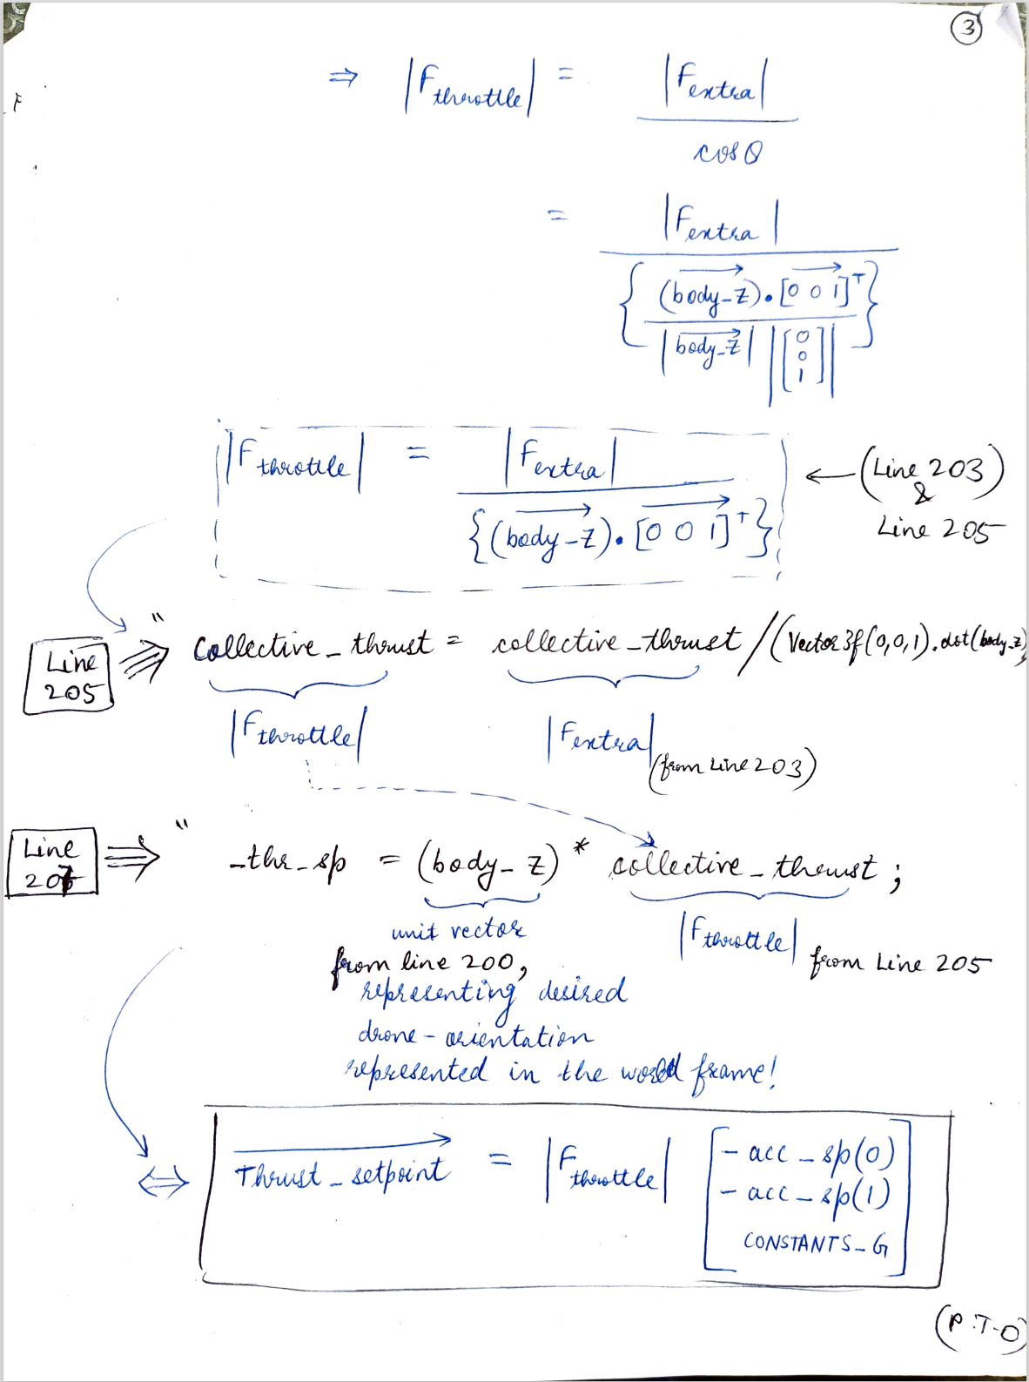
Thrust Setpoint and Acceleration Setpoint (2)
Output of Velocity-PID block
void PositionControl::_accelerationControl
Line 197-208
This is called earlier in void PositionControl::_velocityControl()
mc_pos_control/PositionControl/PositionControl.cpp

Slide 13
Attitude Control

Slide 14
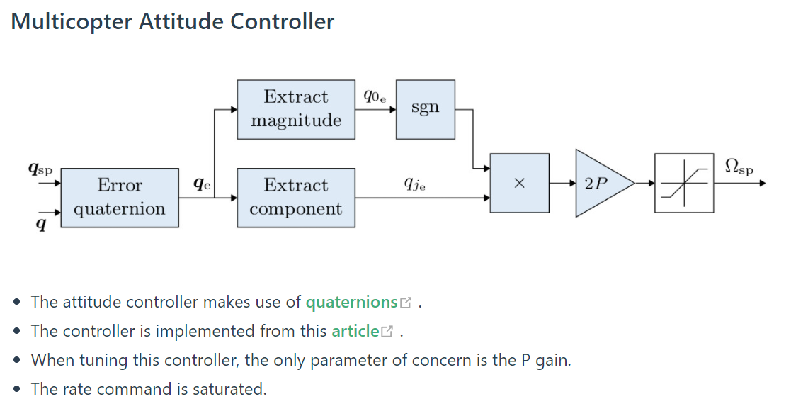
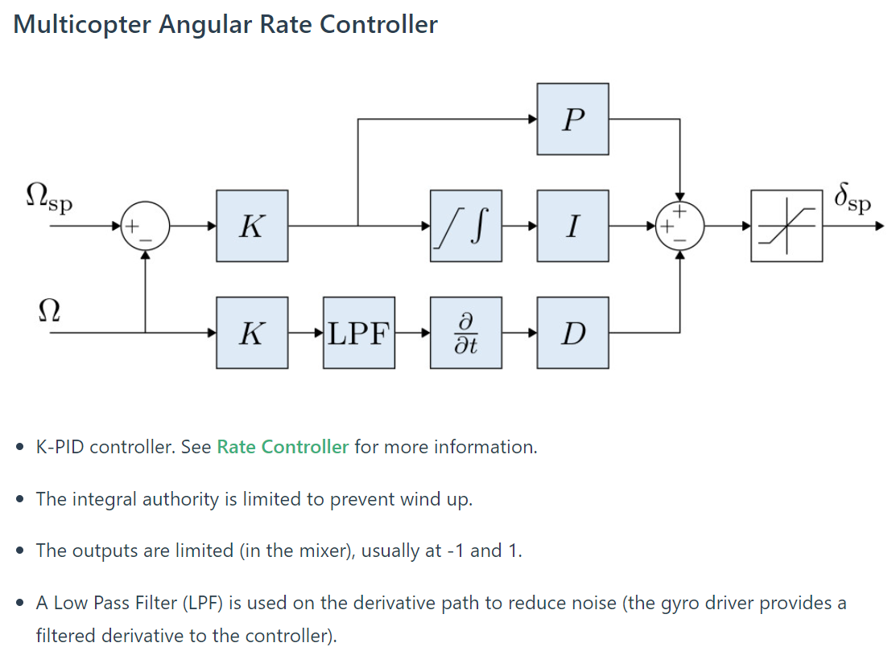
Attitude & Angular Rate Control
http://docs.px4.io/master/en/flight_stack/controller_diagrams.html
**Refer this link for an additional note on IMU pipeline

Slide 15
Codeflow
mc_att_control: (quaternion based control : https://www.research-collection.ethz.ch/bitstream/handle/20.500.11850/154099/eth-7387-01.pdf )
??
??
??
??

Slide 16
Quaternion Starter-Pack
https://www.youtube.com/watch?v=zjMuIxRvygQ
https://github.com/Optimal-Control-16-745/lecture-notebooks-2021/blob/main/Lecture%2013/Lecture%2013.pdf
https://github.com/Optimal-Control-16-745/lecture-notebooks-2021/blob/main/Lecture%2014/Lecture%2014.pdf
https://www.research-collection.ethz.ch/bitstream/handle/20.500.11850/154099/eth-7387-01.pdf
https://ieeexplore.ieee.org/document/9326337

Slide 17
Attitude Setpoint

Slide 18
UUV Control Architecture

Slide 19
Coming soon...
Notes:
The criteria's considered while selecting an environment
We studied both AUV Matlab and Gym AUV before settling on gym AUV
17

Slide 20
**The following slides are for shapes/arrows etc.**
Notes:
The criteria's considered while selecting an environment
We studied both AUV Matlab and Gym AUV before settling on gym AUV
20

Slide 21
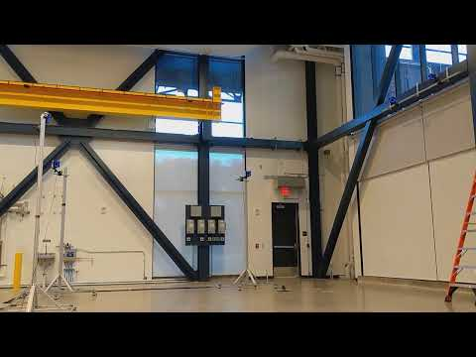
T
2 DIY TBS drones ready
Relevance?
Experience/knowledge transfer to BlueROV platform
Custom Firmware
Need to understand PX4 Codebase first
Insert Drone-Video here, please.

Slide 22
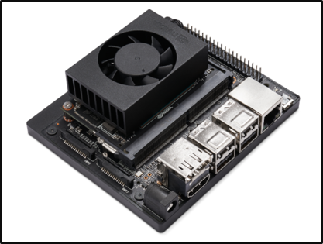
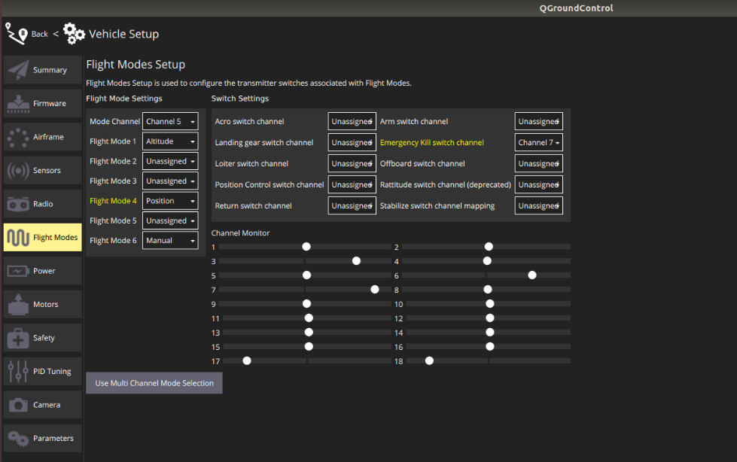
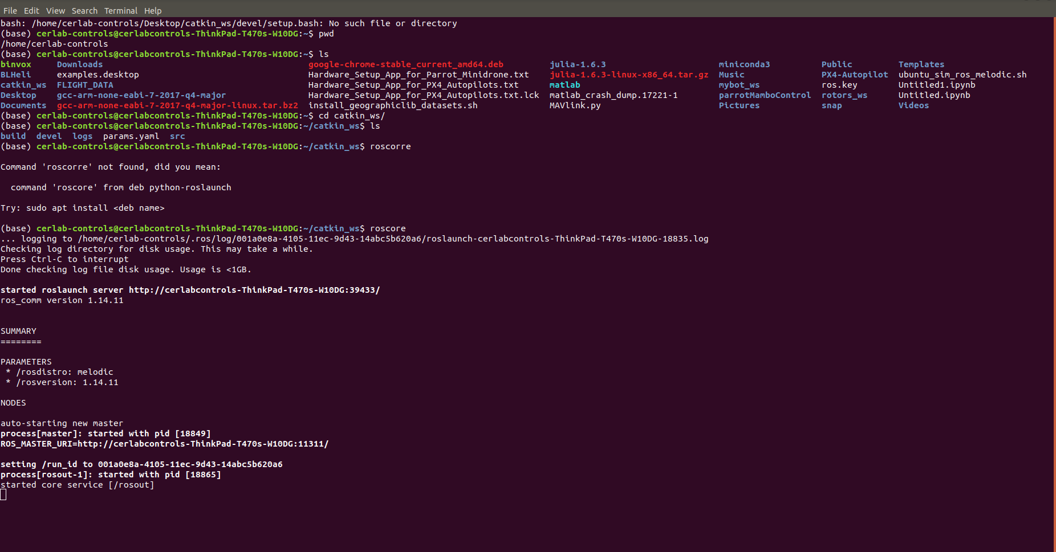
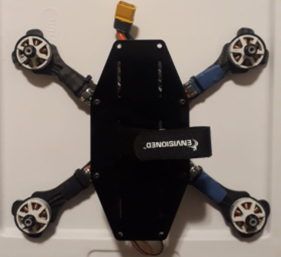
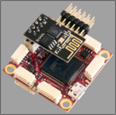
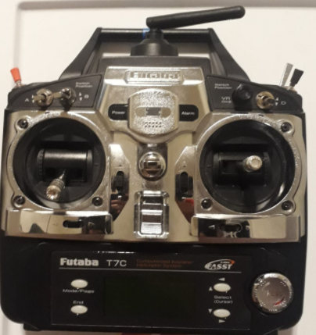
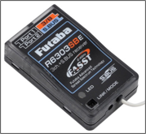
Drone Communication
Onboard Computer^{[1]}
MAVROS
MAVlink
MAVlink
QGround Control Station + Companion Computer
Flight Controller^{[2]}
OptiTrack
MAVlink
Radio
Radio Transmitter
Radio Receiver^{[3]}
Ground Station
Drone
[1] Nvidia Developer, Jetson Xavier NX Developer Kit; Retrieved from: https://developer.nvidia.com/embedded/jetson-tx2-nx
[2] Pixracer-R15 Flight Controller; Retrieved from: https://docs.px4.io/master/en/flight_controller/pixracer.html
[3] Futaba Radio Receiver; Retrieved from: https://www.bhphotovideo.com/c/product/1507099-REG/futaba_01102196_1_r6303sbe_fasst_s_bus_2_4.html/?ap=y&ap=y&smp=y&smp=y&lsft=BI%3A514&gclid=CjwKCAjwoZWHBhBgEiwAiMN66b4V0cBzoYGmVTpGhbsPP8sguX42Til51vwlocrRU7q7cbRuSYWUjRoCSE0QAvD_BwE

Slide 23
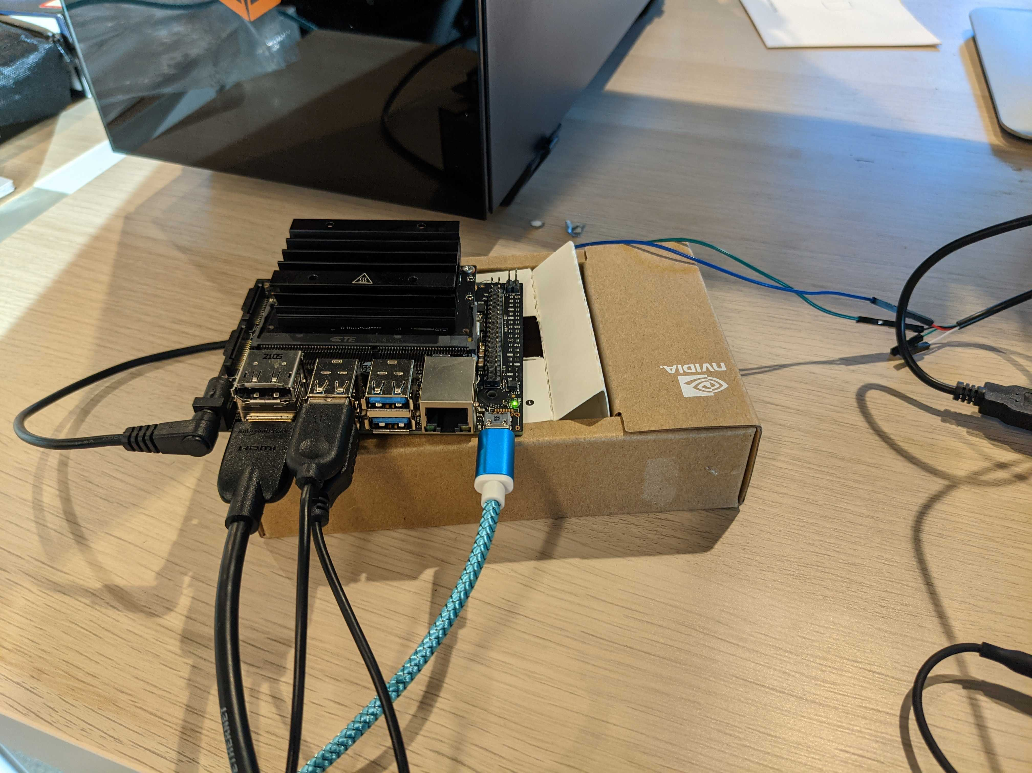
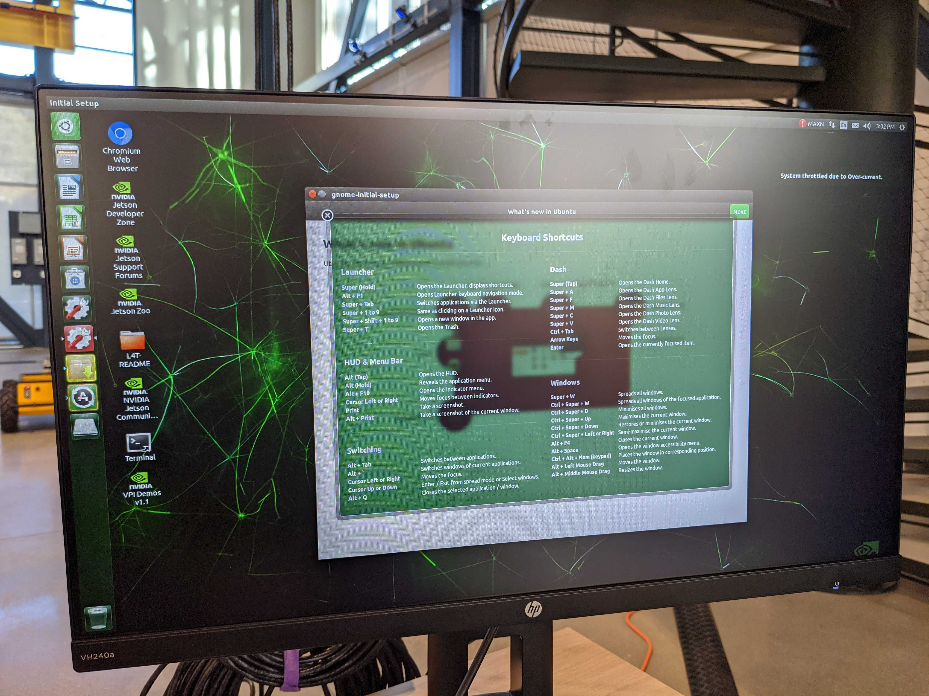
Ongoing and Future Work
Hardware
Software
Mount Jetson Nano onboard
Mount Wifi-modules/Radio telemetry modules if necessary
Reassess hardware design because of increased payload
Brainstorm Tether integration
PX4 Codebase
ROS offboard control
OptiTrack integration
Custom Control Architecture flashing
Reinforcement Learning Research

Slide 24
M
24 ft.
Cheap Mattress → 35-50$ each
Gymnastic mats → 300-400$ each
24 ft.
High Bay Area

